Slide 1
The low achievement trap in middle income countries: comparing botswana and south africa
A “natural experiment” in Botswana and South Africa
Notes:
This study was the outgrowth of many years (since 1998) of efforts to improve educational research training in South Africa, which began with a consortium of universities developing better PHD programs with funding from the Spencer Foundation. We always felt that a large scale empirical project would help build research schools, Fortunately Spencer was willing to continue its support, and this project is the realization of or original vision.

Slide 2
A large comparative Study of student learning gains southern africa
The study was conducted by the Human Sciences Research Council, the University of Botswana, and Stanford University during the year 2009.
Sample: 60 primary schools catering to low-income students on each side of the Botswana-South Africa border.126 6th grade mathematics classrooms and more than 5000 6th grade students in those schools.
The Study tested students in mathematics near the beginning and end of the year.
The Study tested teachers in mathematics, filmed teachers giving a lesson at least once during the year (many twice).
The Study analyzed student notebooks in mid- and end-year to determine curriculum coverage (OTL).
The Study applied detailed questionnaires to students, teachers, and principals.

Slide 3
The main policy results of the study
1. Classroom differences in our sample are much more important in explaining learner mathematics gains in North West than in Botswana.
2. The most important variables that contribute to learner gains in North West are mathematics teaching quality as measured from analyzing videotaped lessons and the number of lessons taught on test topics as measured from notebook analysis.
3. Teacher mathematics knowledge in North West, as measure by our teacher math test, is significantly positively correlated with better teaching quality and more lessons taught on the test topics.
Notes:
NOW THIS MAY SEEM LIKE SAME OLD SAME OLD, AND INDEDED, IN 1998, I HEARD AOUT ABSENTEEISM AND DISCUSSED IT

Slide 4
The bottom line
1. Our study shows that in South Africa the impact on student learning gains of improving mathematics teaching quality (mainly through increasing teacher mathematics knowledge) could be very large.
2. Our study shows that the impact on student learning gains in South Africa of increasing the number of mathematics lessons taught by teachers on required topics could also be very large.
3. It is possible to increase learning gains significantly in Botswana through improving the quality of teaching and teacher mathematics knowledge, but the impact size of such improvement is much smaller than in South Africa.
4. We believe this is the case because Botswana’s educational system is already more “efficient” than South Africa’s, albeit at a rather low performance level.

Slide 5
The Study is a “Natural Experiment”
Students and teachers on either side of the border come from the same cultural grouping, but the school systems have developed in very different historical contexts.
Teachers received somewhat different training, curriculum is similar but was formulated more systematically and with greater teacher participation in Botswana.
Role of teachers has been different historically, and supervision has been different.
We compared how schooling is delivered in the two contexts, and what are the factors that contribute to student achievement gains.
We analyzed whether 6th graders are learning differently in the two contexts.
Notes:
The main advantage of this study over a study such as the SACMEQ, is that besides measuring student achievement gains, which I shall discuss further, we enter deeply into MEASURING directly the PROCESS of schooling—not manly with questionnaire data, but with direct empirical observation, including assessing how well teachers teach mathematic, and how much, what, and at at what pace the teach mathematics during the year. We also do a lot of item analysis, which allows to see what students are learning and not learning. And all our researchers personally observed the classrooms and the teachers teaching.in a number of schools.

Slide 6
Border area including former Bophutatswana homeland

Slide 7
Proposal: students in botswana do better because of a series of small differences in schooling delivery
From our initial observations and other international tests, low-income students in Botswana seem to do somewhat better than students in South Africa.
We proposed that a series of small differences contribute to the observed differences in student learning and learning gains.
To measure these differences, we estimated production functions for mathematics achievement gains in each set of classrooms.
We used cross section (final test) and value added models in order to compare the more usual kind of results from cross-section data such in SACMEQ with the value-added data we collected.
Notes:
Our production functions are much more sophisticated than typical production functions two reasons: 1) ours are based on a theory of learning mathematics, that include classroom processes and the degree of teacher effort; and 2) we use a structural model in which our measures of teacher skills and effort are related to each other as well as to student achievement gains.l

Slide 8
VALUE-ADDED STUDIES ARE IMPORTANT BECAUSE THEY BETTER IDENTIFY “TRUE” CLASSROOM EFFECTS
When we estimate teacher “effects” on student achievement measured at one point in time—say, at the end of the 6th grade—we cannot control for earlier grades’ teacher contributions tp learning.
It is not enough to control for the student’s family background, since there is considerable variation in academic skills of students with similar family backgrounds.
Also, teacher skills are probably not randomly distributed among students with different academic skills or SES. “Better” teachers usually end up in schools with “better” students, for various reasons.
Thus, we don’t know whether better teachers are “causing” higher student test scores measured in that grade, or whether better teachers have chosen or been chosen to work with higher scoring students.
Measuring the change in achievement over a year or from year to year takes care of most of both these problems.

Slide 9
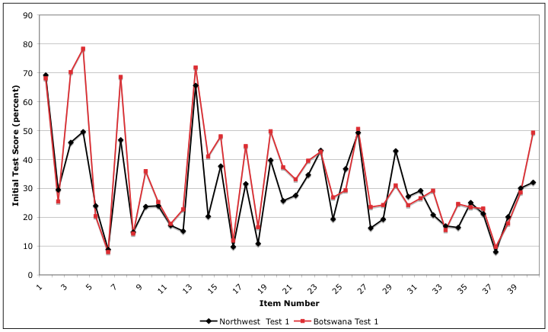
STUDENT ITEM SCORES ON THE INITIAL TEST HAVE THE SAME PATTERN IN NW & BW BUT ARE HIGHER IN BW (RED)

Slide 10
Student Achievement gains in NW are not large and are smaller than in BW (not showN)

Slide 11
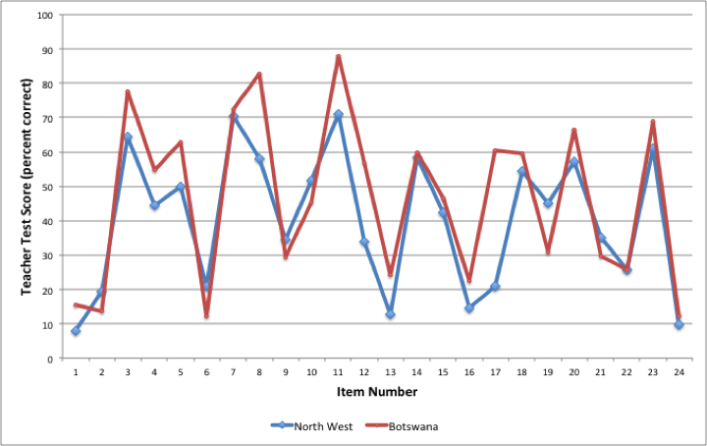
Teacher test ITem Scores in NW & BW have similar pattern but are higher in BW (RED)

Slide 12
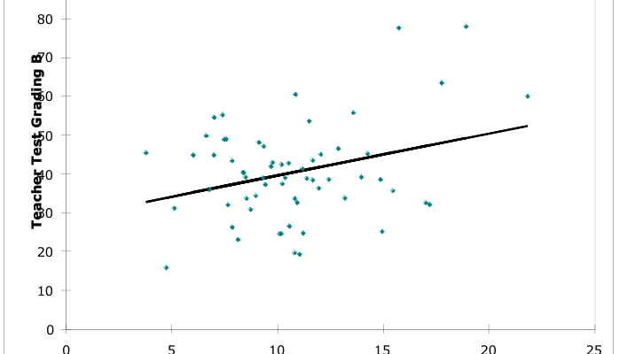
Teacher Test Scores in NW are higher in Classrooms with the highest average SES learners
Notes:
This is not the case in BW. One must also remember that this is a sample of quite low income schools in NW, so even in this low income sample of classrooms, teachers are distributed unequally. The teacher rotation system in BW has other drawbacks, but it does produce greater equality of teacher distribution.

Slide 13
The Number of lessons taught in NW classrooms is much lower than in BW classrooms
Statistic | North West Recorded Lessons | Botswana Recorded Lessons
Mean | 52 | 77.5
Standard deviation | 16.01 | 22.7
Minimum | 21 | 33
Maximum | 97 | 142
Notes:
North West teachers apparently only teach 40 percent of the mandated lessons. But BW teachers only teach 60 percent of the mandated lessons

Slide 14
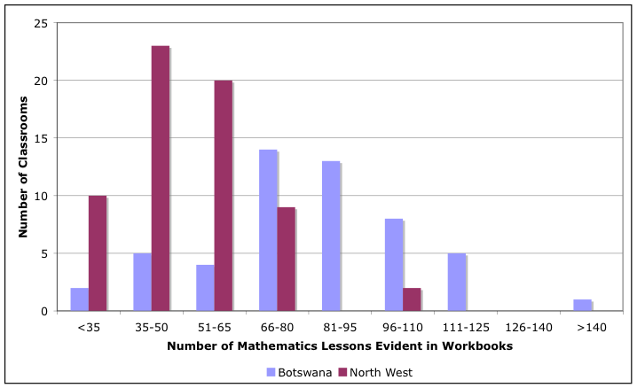
The Frequency of lessons shows that in NW, many teachers are teaching Fewer than 50 from February-early November

Slide 15
In both countries the % of required Topics covered is low
On average the North West sample of classrooms covered
52 percent of the test topics relating to Number, operations and relationships
29 percent of the test topics relating to Space and shape (geometry)
28 percent of the test topics relating to Measurement
18 percent of the test topics relating to Patterns, functions and algebra
14 percent of the test topics relating to Data handling
On average the Botswana sample of classrooms covered
44 percent of the test topics relating to Number, operations and relationships
32 percent of the test topics relating to Space and shape (geometry)
34 percent of the test topics relating to Measurement
16 percent of the test topics relating to Patterns, functions and algebra
21 percent of the test topics relating to Data handling

Slide 16
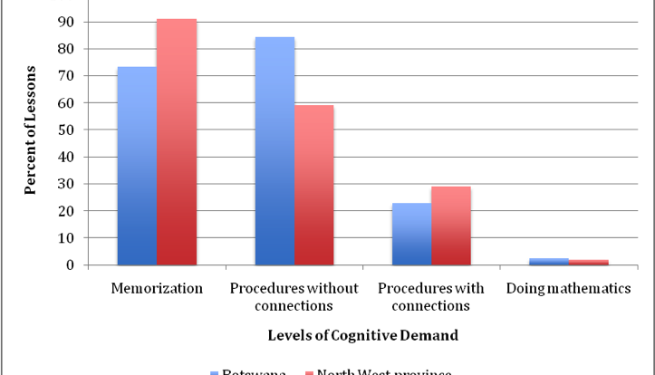
levels of cognitive demand in teaching videotapes almost all memorization or procedures w/o connections
Notes:
Mathematical proficiency (five categories); cognitive demand (three categories).

Slide 17
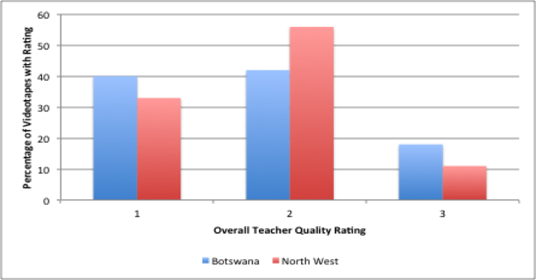
Few Teacher Quality Ratings from Videotapes are “very good (3 rating)

Slide 18
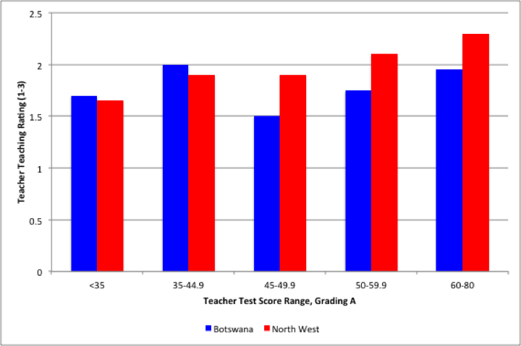
Teacher teaching skill is much more related to teacher math test score in NW (RED) than BW (Blue)

Slide 19
Cross-section & value added results
 | North West Province |  |  | Botswana
 |  | Value Added Models |  |  | Value Added Models
Variable | Post-Test Only | I. Post-Test Controlling for Initial Test Score | II. Test Score Gain (Post-test minus Pre-test score) | Post-Test Only | I. Post-Test Controlling for Initial Test Score | II. Test Score Gain (Post-test minus Pre-test score)
Initial test score |  | 0.5181*** |  |  | 0.7602***
Teacher experience (years) | -0.0045 | -0.0040 | -0.0036 | -0.0004 | 0.0016 | 0.0022
Teacher experience squared | 0.0001 | 0.0001 | 0.0000 | 0.0000 | -0.0001 | -0.0001
Teacher test score B | -0.0007 | -0.0009 | -0.0010 | 0.0010* | 0.0005* | 0.0004*
Better teaching quality ª | 0.0425* | 0.0468** | 0.0508** | 0.0332** | 0.0197** | 0.0154**
Best teaching quality ª | 0.0240 | 0.0237 | 0.0234 | 0.0334 | 0.0177 | 0.0128
Total lessons on topics | 0.0013* | 0.0013* | 0.0012* | 0.0001 | 0.0000 | 0.0000
Observed class size | -0.0005 | -0.0005 | -0.0005 | -0.0004 | -0.0009 | -0.0010*
Average class SES | 0.0103*** | 0.0048* | -0.0004 | 0.0043* | 0.0023 | 0.0016
Class violence index | -0.0010 | 0.0003 | 0.0002 | 0.0008 | 0.0006 | 0.0005
Learner characteristics included? | YES | YES | YES | YES | YES | YES
Constant | 0.3464*** | 0.2129*** | 0.0888 | 0.5740*** | 0.1875*** | 0.065
Adjusted R² | 0.197 | 0.346 | 0.084 | 0.193 | 0.568 | 0.044
Observations | 3530 | 3530 | 3530 | 1666 | 1666 | 1666

Slide 20
The impact on learning gains of improving teaching Quality and lessons taught is large
In NW province improving teaching quality from low to “better” teaching could increase math gains from an average of 3 percentage points to 7-8 percentage points, or almost one-half a standard deviation.
If teachers would increase the number of lessons taught on test topics from an average of 60 lessons to 82 (one standard deviation), our estimate show student gains would increase by 3 percentage points.
In Botswana, improving teaching also has a large effect on student learning gains, but much smaller than in NW, only 2 percentage points.
The effect on learner gains of raising teacher math knowledge in Botswana is positive but very small.

Slide 21
Are Gains Higher in Botswana because of More Resources or Greater Efficiency?
Botswana invests more resources per student than North West Province.
Our results show greater possibilities of improving student achievement in North West Province than in Botswana using existing resources.
There is more “room” for improvement in North West even though resources in neither country are used very effectively: teachers are not very good at teaching mathematics and they teach much less than required.
For North West classrooms to improve student achievement to Botswana levels, they need somewhat more resources and to use those resources more effectively.

Slide 22
Production Possibilities and the issue of Efficiency vs. More resources

Slide 23
Conclusion 1: SA students are not doing well, but there are clear steps to take to improve gains.
Our study suggests that relatively low-income students on the Botswana side of the border perform better than similar South African students.
Reason: The system in Botswana has been more effective in organizing teachers to teach more regularly and has trained them somewhat better in mathematics, and to teach mathematics somewhat more effectively.
This creates room for considerable improvement in South Africa through more effective teacher training and more effective accountability measures to increase student opportunity to learn.
This seems simple, but it is not, since both those deficiencies are the result of many years of better organization in Botswana schools.
On the other hand, the news for Botswana is not so good either. Despite a lot of financial resources and years of better organization, students in Botswana are also learning mathematics at a rather low level.
Botswana may also require a large shift in the way it does things in order to get out of relatively low level equilibrium “trap.”

Slide 24
Conclusion 2. Improvement requires long term goals & a series of steps toward that goal
Implement teacher in-service summer programs designed to increase teacher mathematics content knowledge and mathematics teaching knowledge.
Gradually eliminate academic year, during school in-service training.
Implement accountability systems at the provincial level to increase mathematics lessons taught, curriculum coverage, and teaching content demand.
Drastically improve teacher pre-service training, with greatly increased requirements of content knowledge instruction.

Slide 25
Is it worth getting SA students up to BW levels, which are still low?
Since students in Botswana are only scoring about 6 points higher than students in NW, should be bother to make these big changes just to raise scores to a higher but still low level.
The answer is clearly YES. A one half standard deviation increase in student achievement is a big deal anywhere in the world, even from a low level.
Perhaps, and this is just speculative, improving teaching in SA and increasing the number of lessons might generate other changes that would have interactive and larger effects.
Of course, the idea is also to use such reforms to continue to make more improvements, and to continue to assess the system to find more ways to generate greater gains.

